Slide 1
Introduction to Iteration Part I Course Title: Programming Language II Course Code: CSE 111 Semester: Summer 2020 Lecture-4

Slide 2
Last Lecture
Concept of conditional statement
Logical operators
Conditional Statements
if statement
if..else statement
if..elif..else statement
Nested if statement
Logical connectives

Slide 3
Today’s Lecture
Iteration
while loop
Syntax
Working process
Infinite loop
break and continue keyword
Nested loop

Slide 4
Iteration
Instructing the machine to execute a block of a fixed number of times.
Why iteration?
Lets print “Hello World” several times.
Once:
print("Hello World")
Five times:
print("Hello World")
print("Hello World")
print("Hello World")
print("Hello World")
print("Hello World")
How about 100 times?
Copy and paste print("Hello World")?
How about 5000 times?
Still Copy and paste print("Hello World")?
Why not ask the machine to execute print("Hello World") 5000 times?
Here comes Iteration.

Slide 5
Iteration
There are 2 types of iterative statements in Python.
while loop
Used to execute some instructions fixed number of times
Used with Strings, lists.
for loop/ for each loop
Used with collections like Strings, lists, tuples and dictionaries.
while loop:
Initialization of loop control variable
while conditional expression:
Body of while
increment/decrement of loop control variable
for loop:
for var in collection
Body of for

Slide 6
while loop
Components of while loop:
1. Initial value/Initialization
2. Condition
3. Block of code/ Body of loop
4. Increment/Decrement
count = 1
while count<=5:
print("Hello World")
count+=1
count = 1 Initialization
while count<=5: Condition
print("Hello World")} Body
count+=1 Increment/Decrement

Slide 7
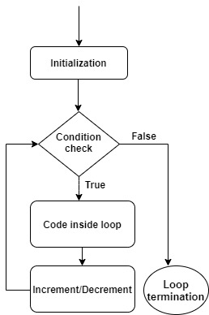
Working process of while loop
count = 1
while count<=5:
print("Hello World")
count+=1

Slide 8
Practice
Try to print all even numbers from 1 to 100.
Now print the even numbers from 100 to 1.
Solution 1:
count = 1
while count<=100:
if count%2 == 0:
print(count,end=" ")
count+=1
Output:
2 4 6 8 10……98 100
Solution 2:
count = 2
while count<=100:
print(count,end=" ")
count+=2
Output:
100 98 96 94 92……4 2

Slide 9
Infinite loop
The program is going to be executed for an infinite period of time.
How?
Why? Because for every case the condition remains true.
Another way to define infinite loop:
count = 5
while count>=1:
print(count)
count+=1
count = 5
while True:
print(count)
count+=1

Slide 10
‘break’ keyword
Used to terminate loop.
count = 1
while True:
print(count)
count+=1
if count==5:
break
Output:
1
2
3
4

Slide 11
‘continue’ keyword
Skip rest of the code for this iteration and start from the condition check again
When the value of count is 3, the program is going to skip all the lines inside the loop and start again from condition check.
Find the output of the code.
count = 0
while count<5:
count+=1
if count==3:
continue
print("Hello",count)
Output
Hello 1
Hello 2
Hello 4
Hello 5

Slide 12
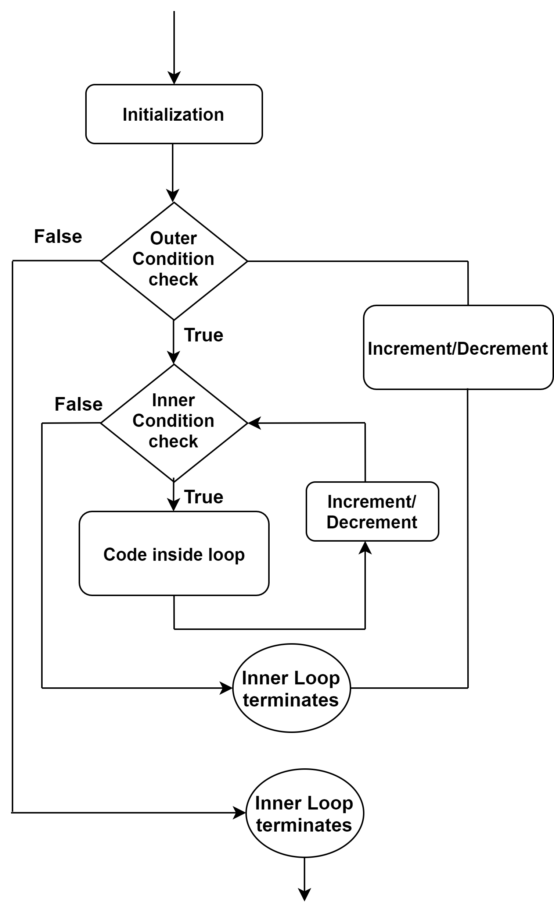
Nested while
A while loop inside another while loop
Find the output of the following code:
outer = 1
while outer <=2:
inner = 1
while inner <=3:
print(outer,",",inner)
inner+=1
print ("Inner loop terminates.")
outer+=1
print ("Outer loop terminates.")

Slide 13
Nested while
Match your output with the following:
outer = 1
while outer <=2:
inner = 1
while inner <=3:
print(outer,",",inner)
inner+=1
print ("Inner loop terminates.")
outer+=1
print ("Outer loop terminates.")
Output
1 , 1
1 , 2
1 , 3
Inner loop terminates
2 , 1
2 , 2
2 , 3
Inner loop terminates
Outer loop terminates

Slide 14
Factorial of n
Take an integer number, n as input and print the factorial of n.
n= input("Enter an integer number: ")
count = int(n)
fact = 1
while count>1:
fact = fact*count
count-=1
print(fact)

Slide 15
Summary
Iteration is required when we try to execute a block of code several times.
There 2 types of iterative statements in python
while loop
for loop/ for each loop
While loop has 4 components
Initialization
Condition
Body of loop
Increment / Decrement
An infinite loop is a loop that runs forever.
We can use break statement to terminate loop.
We can use continue statement to skip some portion of loop body.
Nested loop is a loop inside another loop.

Slide 16
Next Lecture
range () function
Syntax
Reverse range
Concatenation
for loop/ for each loop
Syntax
Iteration of a range
Iteration over a String

Slide 17


